Slide 1
“Unusual” case of Right Ventricular Failure Angelo Micheletti M.D.

Slide 2
A.F., female, 28 yrs.
HISTORY
Postnatal diagnosis: perimembranous, restrictive VSD.
Followed up in another Centre.
9 yrs (1994): surgery
VSD closure with patch.
12 yrs (1997): echocardiogram showed severe tricuspid valve regurgitation, no residual VSD.

Slide 3
16 – 20 yrs (2001 - 2005): three hospital admissions due to shortness of breath on effort. Treated with medical therapy: diuretic and ACE inhibitor.
21 yrs (2006): started on complaining of palpitations.
Holter ECG: frequent VEB, isolated-couples-short non sustained
runs.
21 yrs (2006): hospital admission for cardiac catheterization
normal PAP and PVR, severe Tricuspid regurgitation.

Slide 4
22 yrs (2007): admitted to our Centre for the first time.
EP Study: no inducible arrhythmias.
Cardiac Surgery: Tricuspid valve replacement with 25mm biological
valve.
23-24 yrs (2008-2009): outpatient clinic.
Good general conditions, moderate exercise tolerance, rare
palpitations. No medical therapy.
25 yrs (2010): worsening exercise tolerance. Holter ECG: runs of atrial tachycardia, sporadic SVEBs and VEBs.

Slide 5
25 yrs (2010): Cardiac MR.
Dilated RA and IVC; mild TR; RV EDVI 55 ml/m₂ –
ESVI 24 ml/m₂ , EF 56%. LV EDVI 63 ml/m₂ – ESVI 25 ml/m_{2 ,}
EF 60%.
Commenced on sotalol.
27 yrs (2012) CPET: peak VO₂ 18.6 ml/Kg/min, 54% of predicted, due to cardiovascular impairment.
28 yrs (2013): two episodes of congestive heart failure. NYHA III. Oral furosemide started and sotalol replaced by bisoprolol.
Hospital admission to our Centre.

Slide 6
Physical examination
BP 110/60 mmHg, HR 85 bpm; O₂ sat 96% on room air.
Height 158 cm; weight 52 Kg; BSA 1.5m²
Neck veins: 3-4 cm above the sternal angle.
Chest: chest was clear.
Heart: normal S1 and S2.
Peripheral pulses: normal.
Abdomen: mild hepatomegaly with soft, nontender liver.
Extremities: mild bilateral ankle pitting oedema.

Slide 7
Laboratory data
Hb: 12.3 g/dL
Hematocrit: 36%
Platelet count: 261 x 10⁹ /L
WBC: 9.3 x 10⁹ /L
Creatinine: 0.74 mg/dL
NT-pro-BNP: 70 ng/dL (n.v. <140 ng/dL)
AST: 23 U/L
ALT: 23 U/L
Total Bilirubin: 1.45 mg/dL (n.v. < 1.2)
Albumin: 4.5 g/dL
INR: 1.02

Slide 8
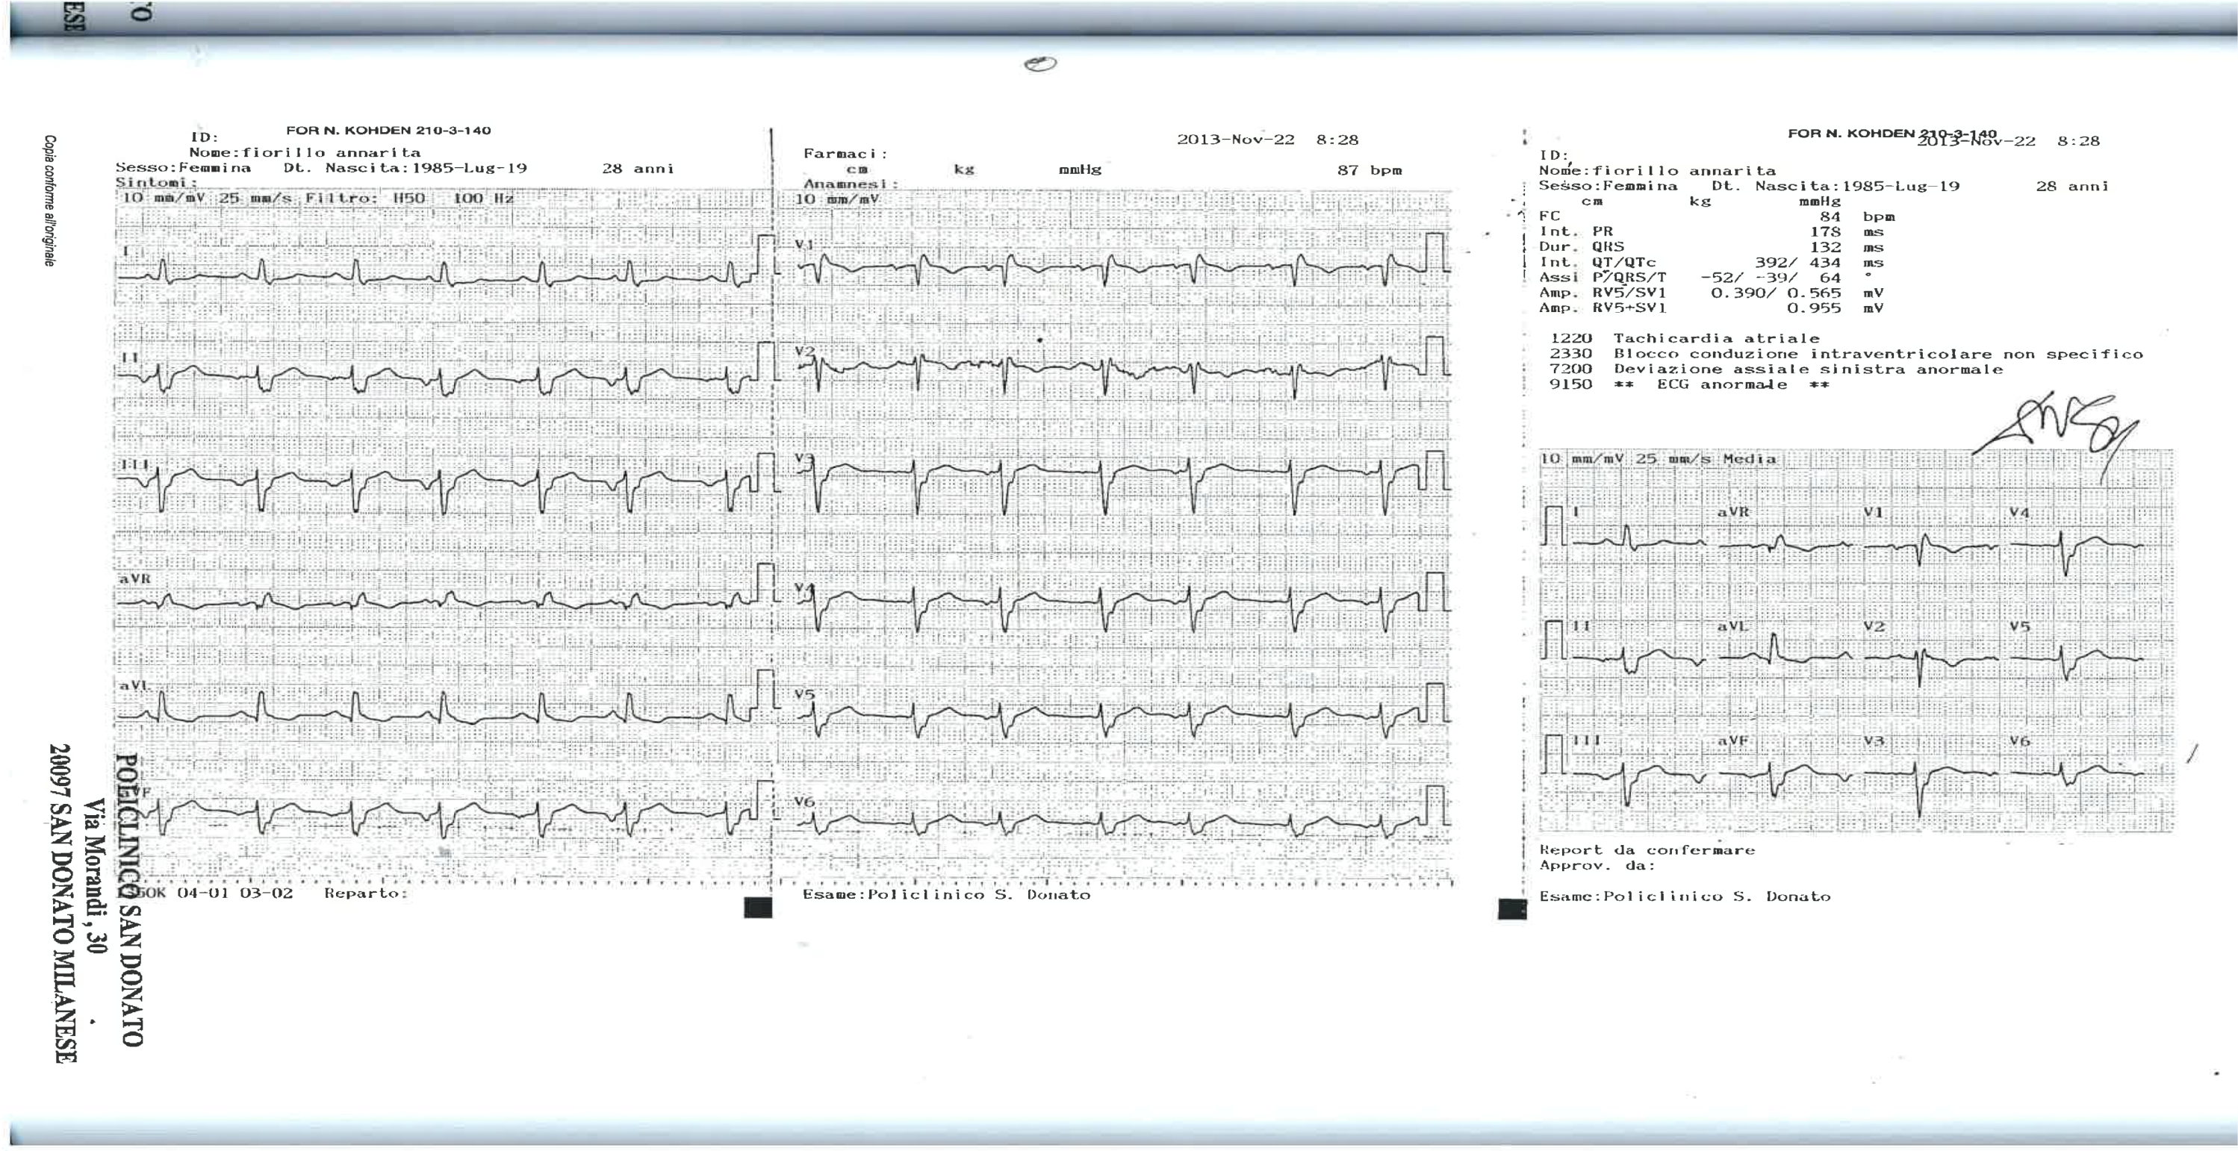
Electrocardiogram
Sinus rhythm, HR 65 bpm. Normal AV conduction. Complete RBBB. Normal repolarisation.

Slide 9
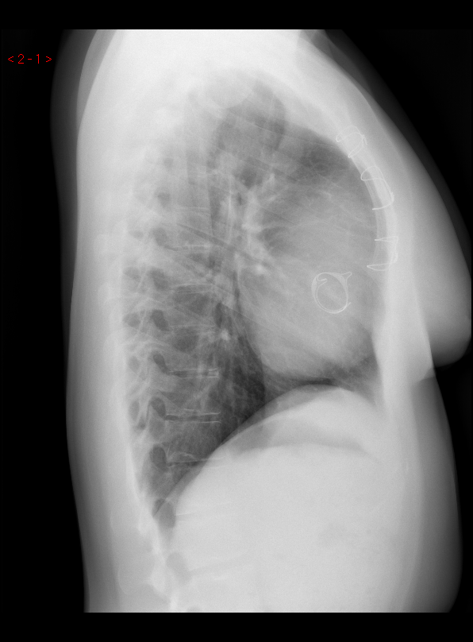
Chest X-Ray

Slide 10
Cardiopulmonary Exercise Test
Exercise protocol | Ramp, 10W/min
Work rate (watts) | 37
Reason for stopping | dizziness
ECG changes | none
 | Rest | Peak
Heart rate (bpm) | 82 | 111
Percent of age-predicted max HR |  | 57
O₂ saturation (%) | 99 | 98
Blood pressure (mmHg) | 90/70 | 110/70
Peak VO₂ (ml/Kg/min) |  | 15.4
Percent predicted (%) VO₂ |  | 45
RER |  | 0.9
Ve/VCO₂ |  | 46
VO₂ /W |  | 4

Slide 11
Cardiopulmonary Exercise Test
Conclusion:
severe reduction of exercise capacity due to cardiovascular, respiratory impairment and physical deconditioning.

Slide 12
Echocardiogram: findings
Dilated RA and IVC with poor respiratory collapse.
Well functioning bioprosthesis in tricuspid valve position.
“Bipartite” RV with small apical portion and dilated RVOT; mildly reduced systolic function.
Normally sized LV with normal systolic and diastolic function.
Normal aestimated PA pressure.

Slide 13
Echocardiogram

Slide 14
Echocardiogram

Slide 16
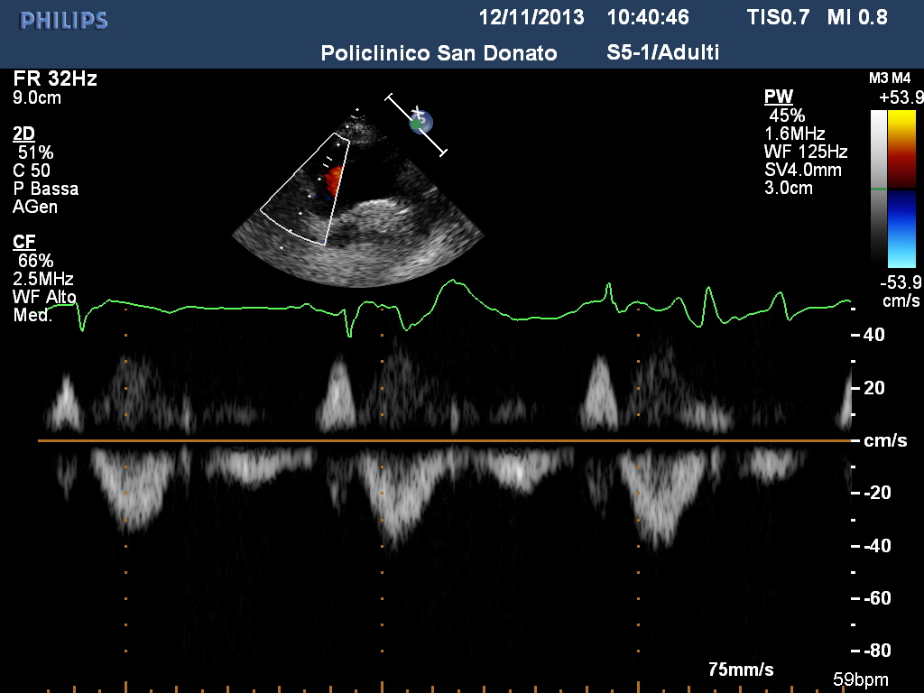
Echocardiogram
Inferior Vena Cava
Superior Vena Cava

Slide 17
Cardiac MR: findings
Dilated RA, 29 cm² area.
Trivial bioprostesis regurgitation.
RV: EDVI 32 ml/m² , ESVI 17ml/m² , SV 24 ml, EF 48%
LV: EDVI 39 ml/m² , ESVI 17ml/m² , SV 35 ml, EF 57%
“Hypoplastic” RV apical portion. Dilated RVOT.
No intracardiac shunt.

Slide 18
Cardiac MR

Slide 19
Cardiac MR

Slide 20
Cardiac MR

Slide 21
Cardiac MR

Slide 22
Cardiac MR

Slide 23
Cardiac MR

Slide 24
Cardiac MR

Slide 25
Catheterization
 | Pressure | Saturation (%)
SVC
IVC
RA | 14/7/ mean 10
RV | 24/10
PA | 25/7/ mean 13
LV | 113/15
Aorta | 113/59 mean 82 | 98
LA

Slide 26
Catheterization: angiograms

Slide 27
Catheterization: angiograms

Slide 28
Catheterization: angiograms

Slide 29
Catheterization: angiograms

Slide 30
Final Diagnosis
Markedly reduced exercise capacity.
Signs of RV failure.
Well functioning tricuspid bioprosthesis.
“Bipartite” and dysfunctional RV.
Normal PAP.

Slide 31
Plan of action
Conservative management?
ASD creation?
One and half ventricle?

Slide 32
Outcome
One and a half ventricle
11/2013, bidirectional cavo-pulmonary anastomosis.
Intraoperative: after CPB, SVC pressure 15 mmHg.
Postoperative: uneventful recovery.
Discharged on furosemide (25 mg twice daily),
hydrochlorothiazide (12.5 mg), bisoprolol and aspirin.

Slide 33
Follow up: 3 months
NYHA II.
No peripheral oedema, no hepatomegaly.
No arrhythmias.
On echo: well functioning Glenn and bioprosthesis. Smaller RA area and IVC.

Slide 34
Follow up
Therapy: hydrochlorothiazide stopped.
Still on furosemide, aspirin and bisoprolol.
CPET and cardiac MRI in 3 months’ time.

Slide 35
Thank you for your attention!

